Slide 1
Socket Interface
Training Division

Slide 2
Contents
Some definitions
Sockets
Socket Types
Client Server Model
Types of Server
Socket Data structures
Socket System Calls
Byte Ordering
Byte manipulation functions
Information About Remote Host
Connection-less and Connection-Oriented server
UDP client-server programs
TCP client-server programs

Slide 3
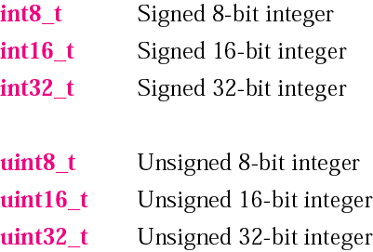
Data types

Slide 4
Sockets
What is a socket?
A descriptor that lets an application read/write from/to the network
Similar abstraction for network I/O as file I/O
Clients and servers communicate by reading/writing from/to socket descriptors
Sockets can be either connection based or connectionless: Is a connection established before communication or does each packet describe the destination?

Slide 5
Socket types
The socket types are:
Stream Sockets
  stream sockets treat communications as a continuous stream of characters.
  is a reliable.
  connection oriented.
Datagram Sockets
  datagram sockets have to read entire messages at once.
  is unreliable and message oriented
  connection less.
Raw Sockets
  provides users access to the underlying communication protocols which support socket abstractions

Slide 6
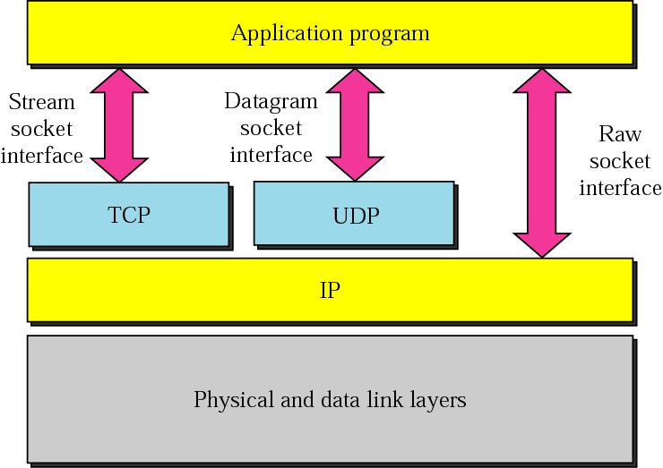
Socket Types

Slide 7
Client Server Model
Most widely used network applications.
Server : Any process that offers some service over the network.
Client : It sends a request to the server and waits for response.
Servers can be categorized as
Iterative servers
    Concurrent servers

Slide 8
Types of servers depending on the service
Depending on whether a server is using TCP or UDP protocol to transmit messages, it can be categorized as connection oriented or connection less.
Connection oriented -> server program should be started first, and sometime later the client must be started which connects to server.
Connection less -> Connection establishment is not required here.

Slide 9
Socket data Structure
#include<netinet/in.h>
struct sockaddr_in {
unsigned short sin_family; /* address family (always AF_INET) */
unsigned short sin_port; /* port num in network byte order */
struct in_addr sin_addr; /* IP addr in network byte order */
unsigned char sin_zero[8]; /* pad to sizeof(struct sockaddr) */
};
#include<sys/socket.h>
struct sockaddr {
u_short sa_family; /* addess family*/
char sa_data[14]; /* protocol specific address*/
}
IP address and port number must be stored in network byte order.

Slide 10
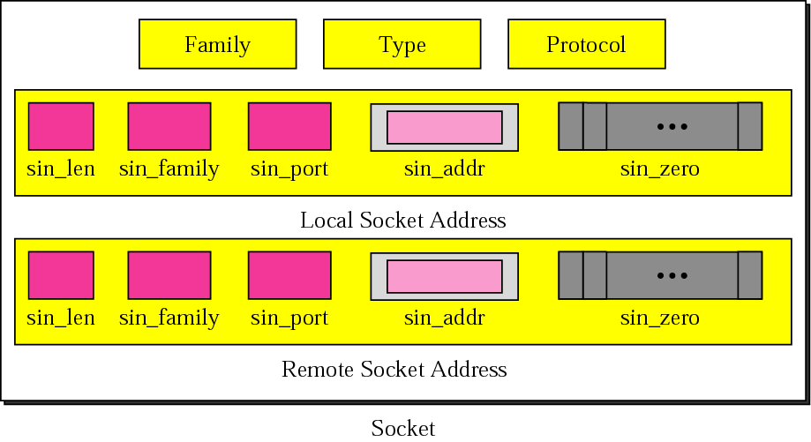
Socket structure

Slide 11
An analogy:
Socket: telephone
Bind: assign telephone number to a telephone
Listen: turn on the ringer so that you can hear the phone call
Connect: dial a phone number
Accept: answer the phone
Read/write: talking
Close: ???
‏
‏

Slide 12
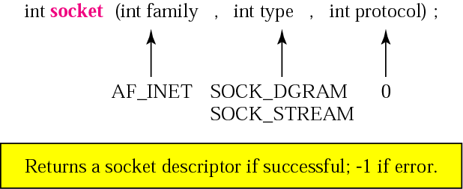
SOCKET SYSTEM CALLS

Slide 13
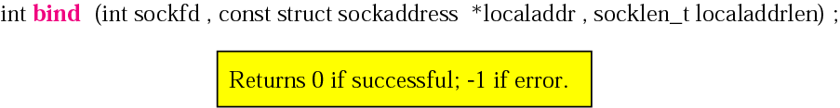
bind ()‏
Sets the value for local socket address
Usually called by client/ server

Slide 14
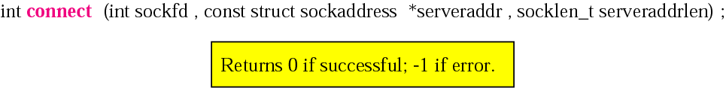
connect()‏
Usually used by the client to establish an active connection
Sets value for remote socket address

Slide 15
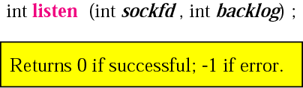
listen()‏
Called by TCP server
Informs the OS that server is ready to accept connection
Backlog is the number of requests that can be queued for this connection

Slide 16
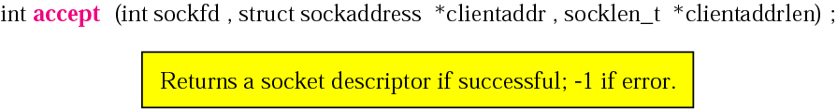
accept()‏
Called by the TCP server to remove the first connection request from the queue
Creates a new socket(child socket) that can be used by the child server to connect to the client (as in case of concurrent servers)‏

Slide 17
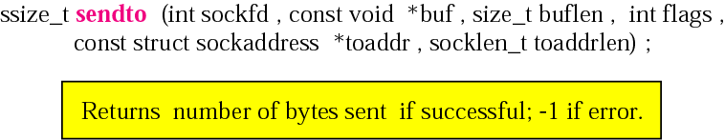
sendto()‏
To send a message to another process using UDP
Flag specifies out-of-band data or lookahead messages

Slide 18
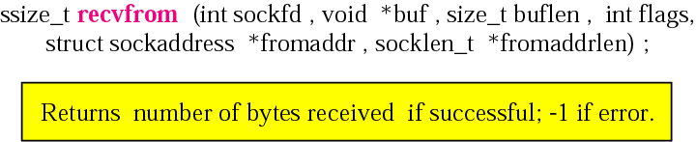
recvfrom()‏
Extracts the next message that arrives at socket

Slide 19
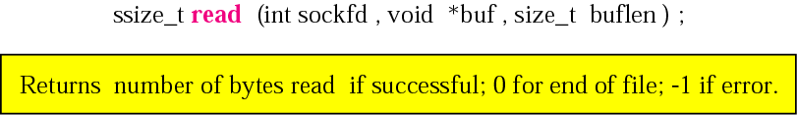
read ()‏
Used by a process to receive data from another process
Assumes that there is already an open connection

Slide 20
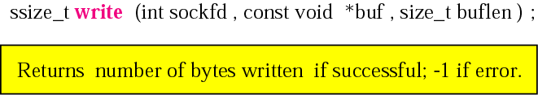
write()‏
Used by a process to send data to another process running on remote machine

Slide 21
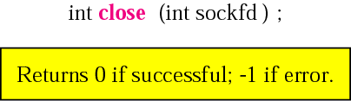
close()‏
To close the connection and terminate the TCP connection
Socket descriptor is no longer valid after calling this function

Slide 22
Socket system calls for connection-oriented protocol
Server
Socket()‏
Connection oriented communication
Bind()‏
Listen()‏
Accept()‏
Client
Socket()‏
Block until
connection
from client
Connect()‏
Data ( request)‏
Write()‏
Read()‏
Process request
Data ( reply)‏
Read()‏
Write()‏

Slide 23
Socket system calls for connectionless protocol
Server
Socket()‏
Connectionless Communication
Bind()‏
Recvfrom()‏
Client
Socket()‏
Block until
Data request
from client
Bind()‏
Data (request)‏
Sendto()‏
Process request
Data (reply)‏
Sendto()‏
Recvfrom()‏

Slide 24

Byte Ordering
The byte order for the TCP/IP
protocol suite is big endian.

Slide 25
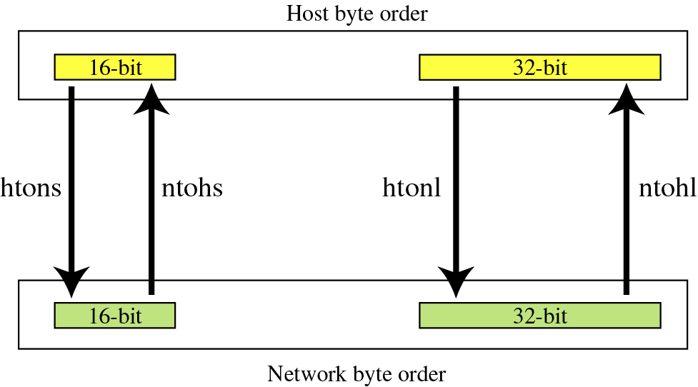
Byte-order transformation

Slide 26
Declaration of byte order transformations
u_long htonl(u_long hostlong);
convert host-to-network, long integer
u_short htons(u_short hostshort);
convert host-to-network, short integer
u_long ntohl(u_long netlong);
convert network to host, long integer
u_short ntohs(u_short netshort);
convert network to host, short integer

Slide 27
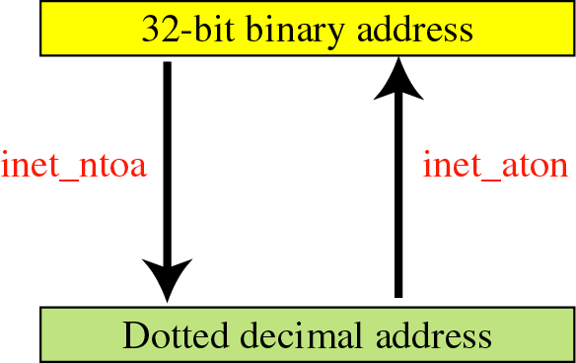
Address transformation

Slide 28

Declarations for address transformation
functions

Slide 29
Information About Remote Host
struct hostent *gethostbyname(const char *hostname);
/* DNS host entry structure */
struct hostent {
char *h_name; /* official domain name of host */
char **h_aliases; /* null-terminated array of alias domain */
int h_addrtype; /* host address type (AF_INET) */
int h_length; /* length of an address, in bytes */
char **h_addr_list; /* null-terminated array of in_addr structs */
};
#define h_addr h_addr_list[0] /* first entry in h_addr_list */
The gethostbyname*() and gethostbyaddr*() functions are obsolete. Applications should use getaddrinfo(3) and getnameinfo(3) instead

Slide 30
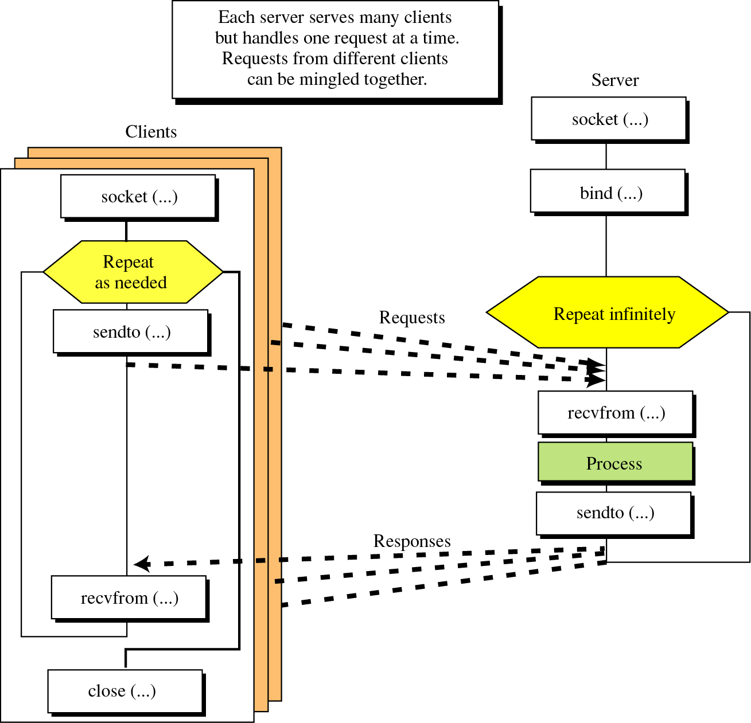
Connectionless Iterative Server
Socket interface for connectionless iterative server

Slide 31
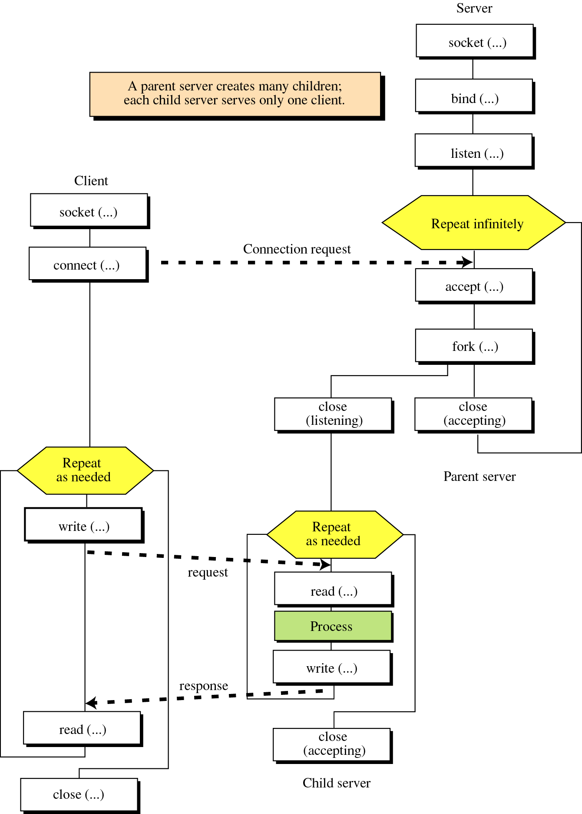
Connection-Oriented Concurrent Server
Socket interface for connection -oriented concurrent server

Slide 32
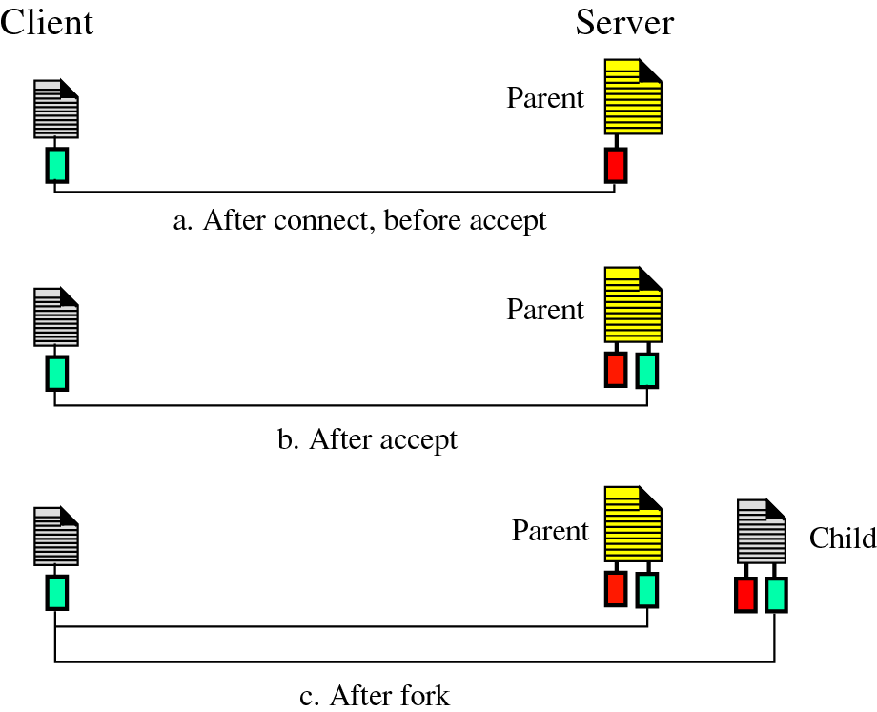
Client and Server

Slide 33
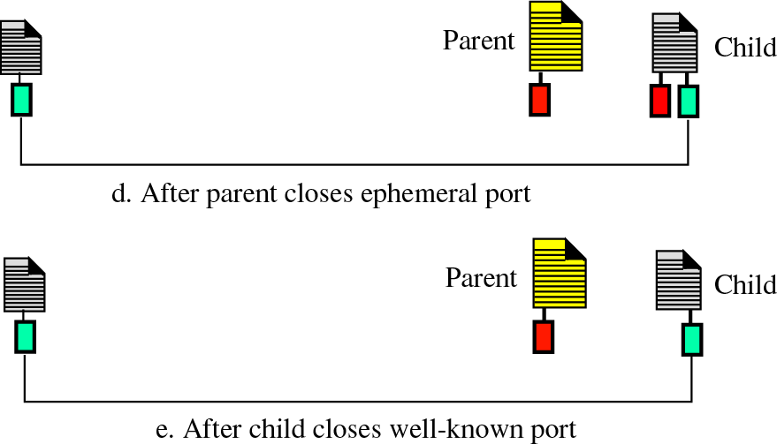
Client and Server (contd)...

Slide 34
UDP Client-Server Program
UDP Server
#define MAXBUF 256
void main(void)‏ {
char buf[MAXBUF];
int passiveSocket;
socklen_t clientAddrLen;
struct sockaddr_in serverAddr;
struct sockaddr_in clientAddr;
passiveSocket= socket(AF_INET,SOCK_DGRAM,0);
memset(&serverAddr, 0, sizeof(serverAddr));
serverAddr.sin_family=AF_INET;
serverAddr.sin_port= htons(a-well-known-port);
serverAddr.sin_addr.s_addr= htonl(INADDR_ANY);
bind(passiveSocket, &serverAddr, sizeof(serverAddr));

Slide 35
UDP Client-Server Program (Cond)...
clientAddrLen=sizeof(serverAddr);
memset(buf,0,MAXBUF);
for(; ;)‏ {
while(recvfrom (passiveSocket, buf, MAXBUF, 0, &clientAddr, &clientAddrLen)>0 )‏ {
PROCESS(..........);
sendto(passiveSocket,buf,MAXBUF,0,&clientAddr,
&clientAddrLen)
memset(buf,0,MAXBUF);
}
}
}

Slide 36
UDP Client
#define MAXBUF 256
void main(void)‏
{
char buf[MAXBUF];
int activeSocket;
socklen_t remoteAddrLen;
struct sockaddress remoteAddr;
struct sockaddress localAddr;
activeSocket= socket(AF_INET,SOCK_DGRAM,0);
memset(&remoteAddr, 0, sizeof(remoteAddr));
remoteAddr.sin_family=AF_INET;
remoteAddr.sin_port= htons(a-well-known-port);
hptr= gethostbyname(“a-domaim-name”);
memcpy((char*)&remoteAddr.sin_addr.s_addr,
hptr->h_addr_list[0],hptr->h_length) ;

Slide 37
UDP Client (Contd)...
memset(buf,0,MAXBUF);
while(gets(buf))‏ {
sendto(activeSocket,buf,sizeof(buf),0,&remoteAddr,
sizeof(remoteAddr);
memset(buf,0,sizeof(buf));
recvfrom(activeSocket,buf,MAXBUF,0,&remoteAddr,
&remoteAddrLen);
printf(“%s\n”,buf);
}
close(activeSocket);
}

Slide 38
TCP Client-Server Programs
TCP Server
#define MAXBUF 256
void main(void) {
char buf[MAXBUF];
int listenSocket;
int acceptSocket;
socklen_t clientAddrLen;
struct sockaddress serverAddr;
struct sockaddress clientAddr;
listenSocket = socket(AF_INET, SOCK_STREAM, 0);
memset(&serverAddr, 0 ,sizeof(serverAddr));
serverAddr.sin_family = AF_INET;
serverAddr.sin_port= htons(a-well-known-port);
serverAddr.sin_addr.s_addr= htonl(INADDR_ANY);
bind(listenSocket, &serverAddr, sizeof(serverAddr));
listen(listenSocket, 1);

Slide 39
TCP Server (Contd)...
clientAddrLen= sizeof(clientAddr);
for(; ;)‏ {
acceptSocket= accept(listenSocket , &clientAddr,
&clientAddrLen );
pid = fork();
if (pid > 0 ) { /* parent */
close(acceptSocket );
continue;
}
else { /* child */
close(listenSocket);
memset(buf , 0 , MAXBUF);
while(read(acceptSocket, buf ,MAXBUF) > 0)‏{
PROCESS(...........);
memset(buf, 0 , MAXBUF);
write(acceptSocket, buf, MAXBUF);

Slide 40
TCP Server (Contd)...
memset(buf, 0 , MAXBUF);
} /* while*/
close(acceptSocket);
} /* else */
} /* for */
}

Slide 41
TCP Client
#define MAXBUF 256
void main(void) {
char buf[MAXBUF];
int activeSocket;
struct sockaddress remoteAddr;
struct sockaddress localAddr;
struct hostent *hptr;
activeSocket = socket(AF_INET, SOCK_STREAM, 0);
memset(&remoteAddr, 0 ,sizeof(remoteAddr));
remoteAddr.sin_family = AF_INET;
remoteAddr.sin_port= htons(a-well-known-port);
hptr= gethostbyname(“a-domaim-name”);
memcpy((char*)&remoteAddr.sin_addr.s_addr,
hptr->h_addr_list[0], hptr->h_length) ;
connect(activeSocket, remoteAddr, sizeof(struct sockaddress))‏
memset(buf,0,MAXBUF);

Slide 42
TCP Client (Contd)...
while(gets(buf))‏ {
write(activeSocket, buf, MAXBUF);
memset(buf, 0, MAXBUF);
read(activeSocket, buf, MAXBUF);
printf(“%s\n”,buf);
memset(buf,0,MAXBUF);
}
close(activeSocket );
}

